Slide 1

Sprint Pace
Garmin Connect IQ Challenge
By: Joshua Norman

Slide 2
Built from rise of new challenges during Covid-19, Sprint Pace is designed as a tool to help athletes at any stage complete time trials during independent exercise.

Slide 3
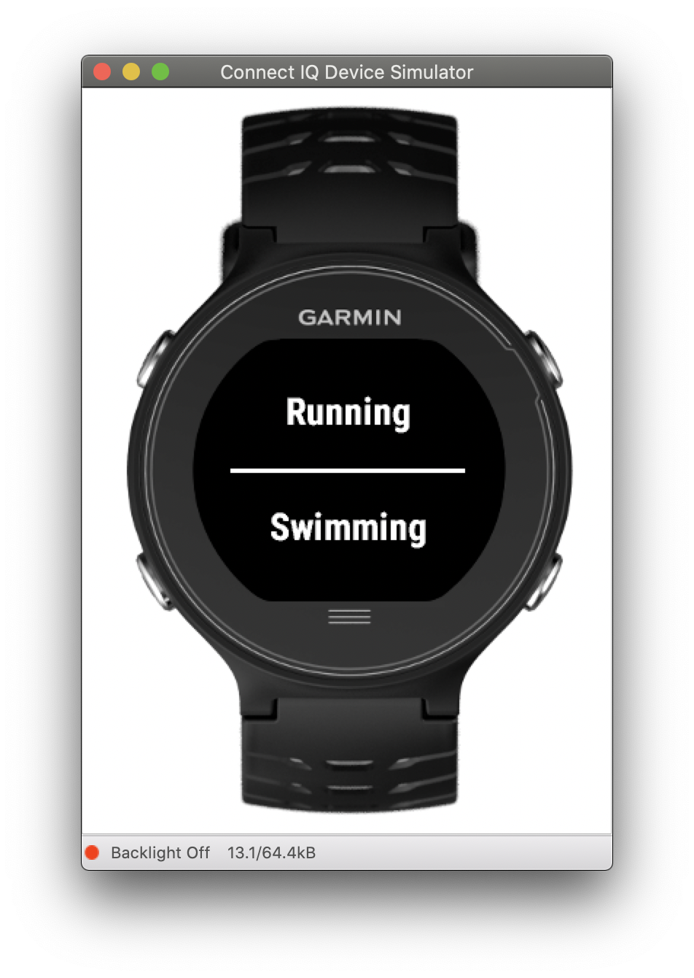
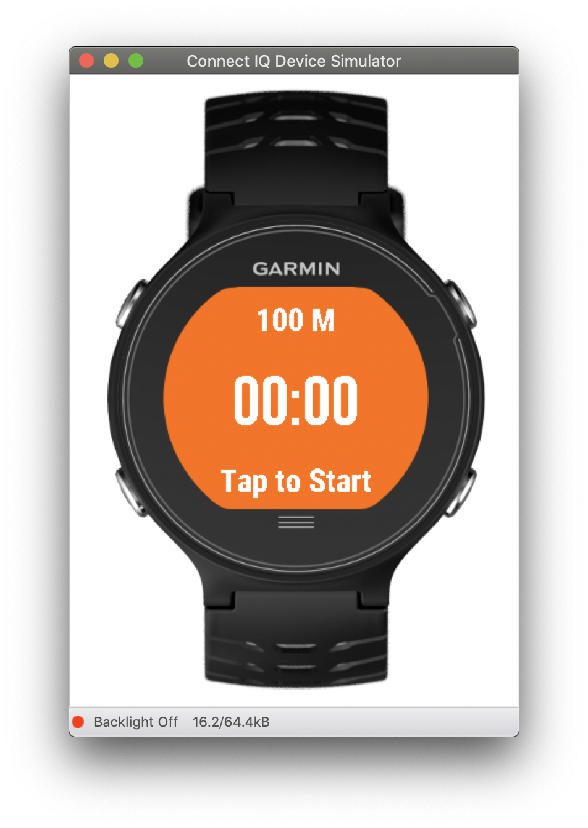
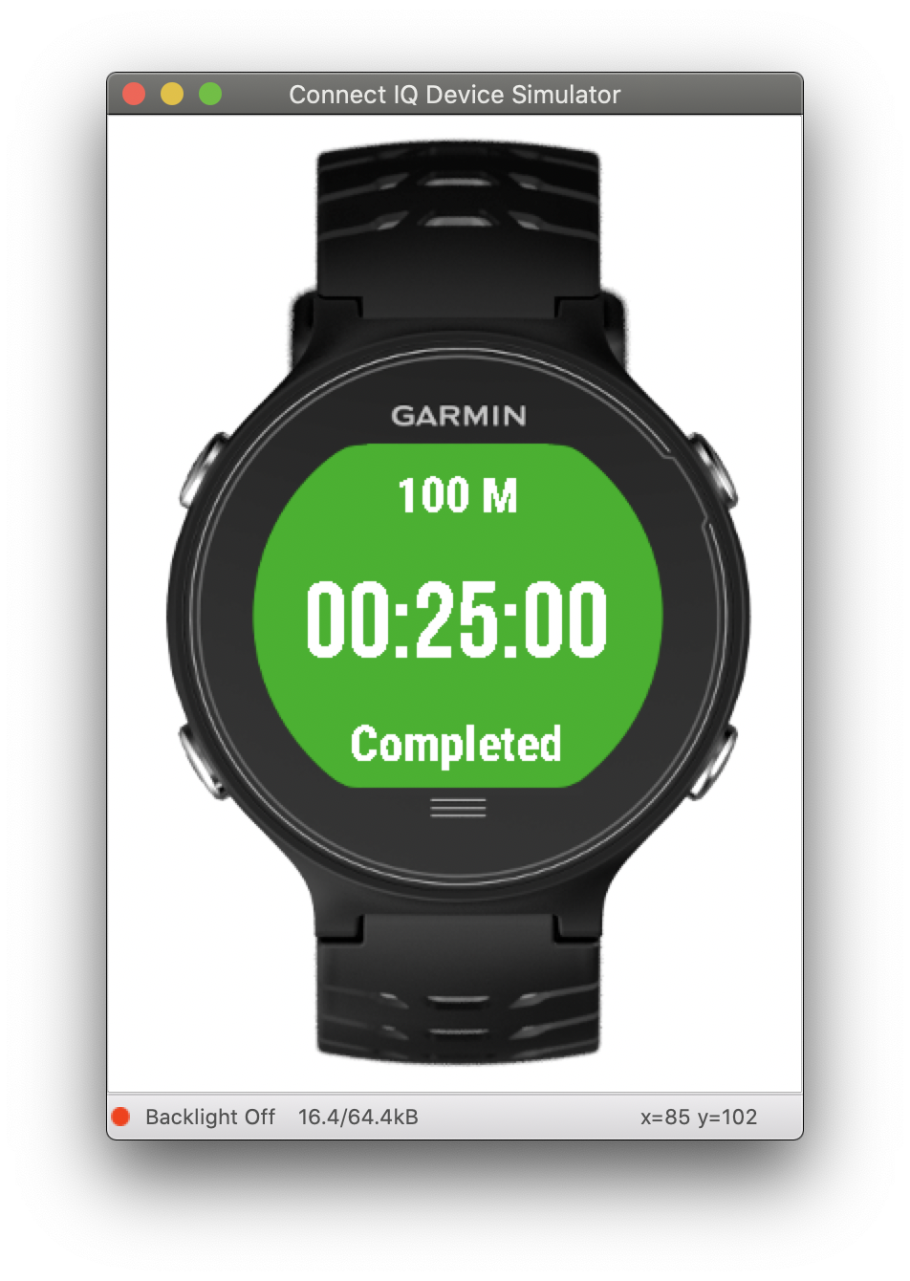
Sprint Pace
No more awkward finishes with one hand on a your watch or waiting for Auto Pause Detection. Sprint Pace focuses on your goals so you don’t have to. Equipped with a countdown and a number of standard distances for running and swimming, Sprint Pace can be your next favorite workout tool to help you Beat Yesterday

Slide 4
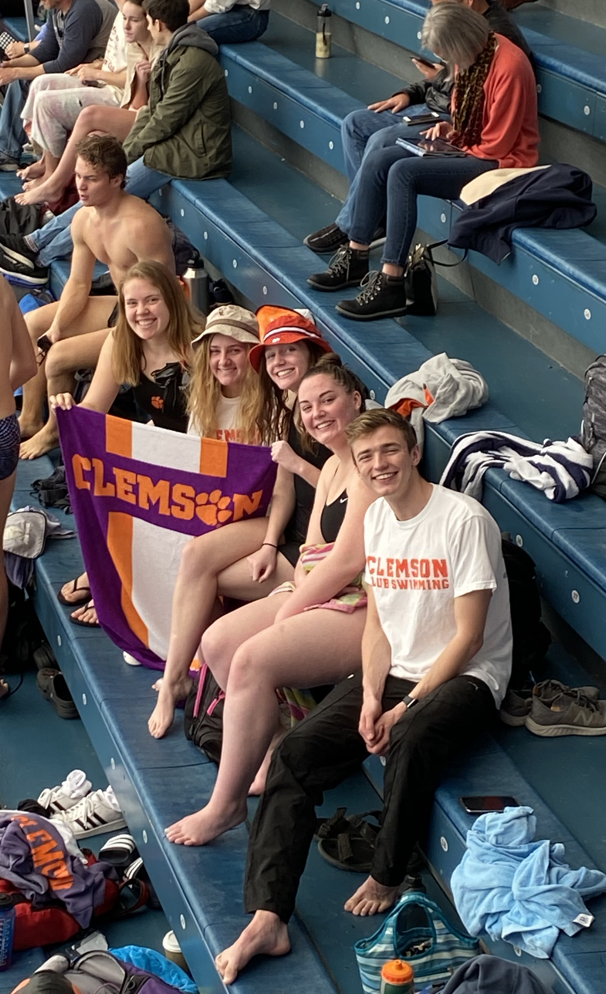
Inspiration
Sprint Pace was developed out of personal necessity to help my friends and I continue to improve while being socially distant. This Fall a number of sports have been canceled leaving many athletes without the tools needed to help them train.

Slide 5




Development Process
Learning & Development
Designing
Testing
Notes:
Wireframe -> Learning and Development -> Testing

Slide 6
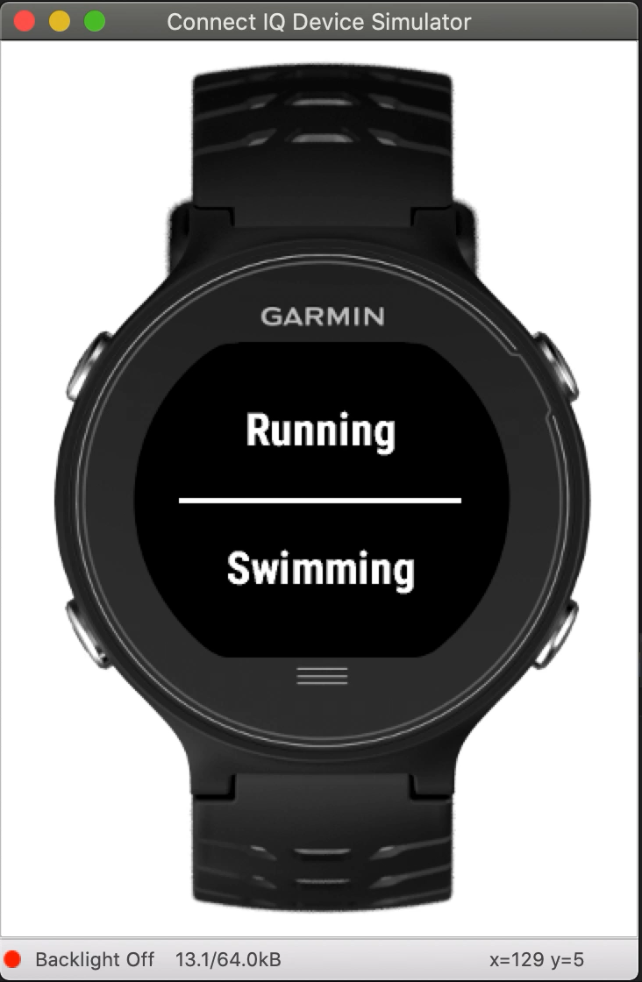
Demo
See it for yourself on GitHub:
https://github.com/jmnorma/SprintPace

Slide 7
Where is it going
Currently I have reached out to many club sports organizations on Clemson’s campus to gain interest and input on the project as we move closer to the Fall semester
I plain to continue develop additional features for Split Pace such as a database to monitor growth over time or an IOS/Android companion app to set goals

Slide 8
Resources
https://developer.garmin.com/connect-iq/api-docs/
https://developer.garmin.com/connect-iq/programmers-guide/
https://www.adobe.com/products/xd.html
https://www.adobe.com/products/illustrator.html
https://www.eclipse.org

